Slide 1


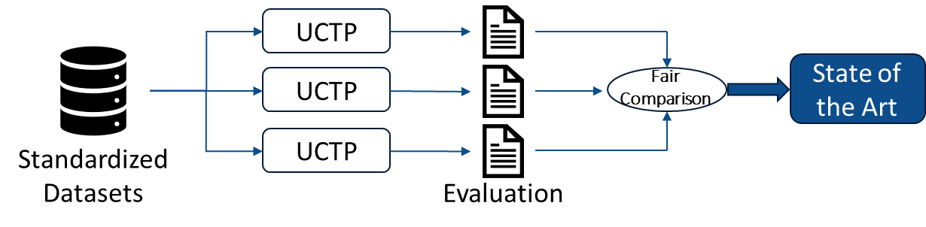
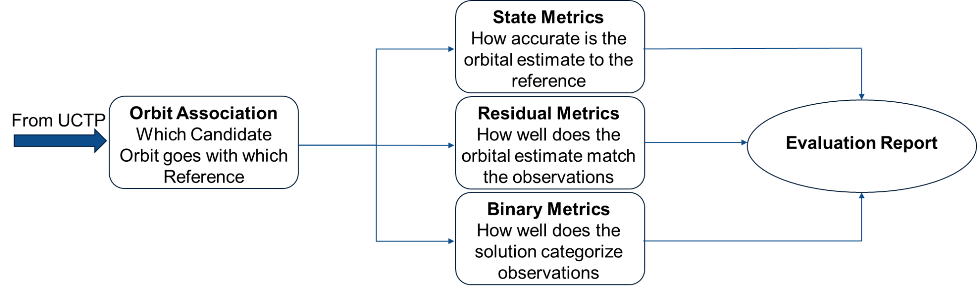
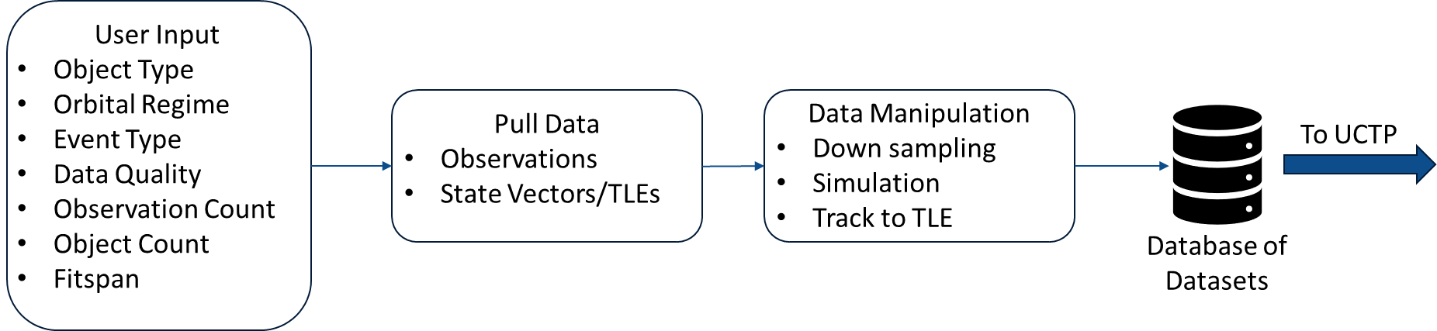
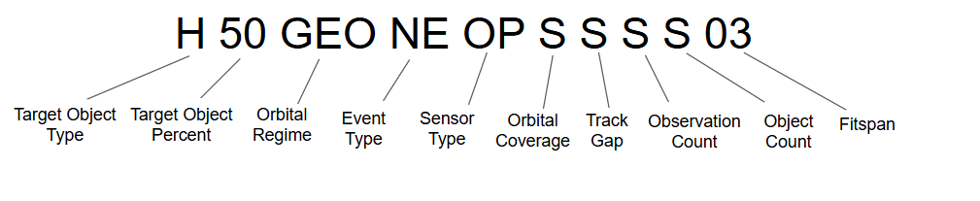
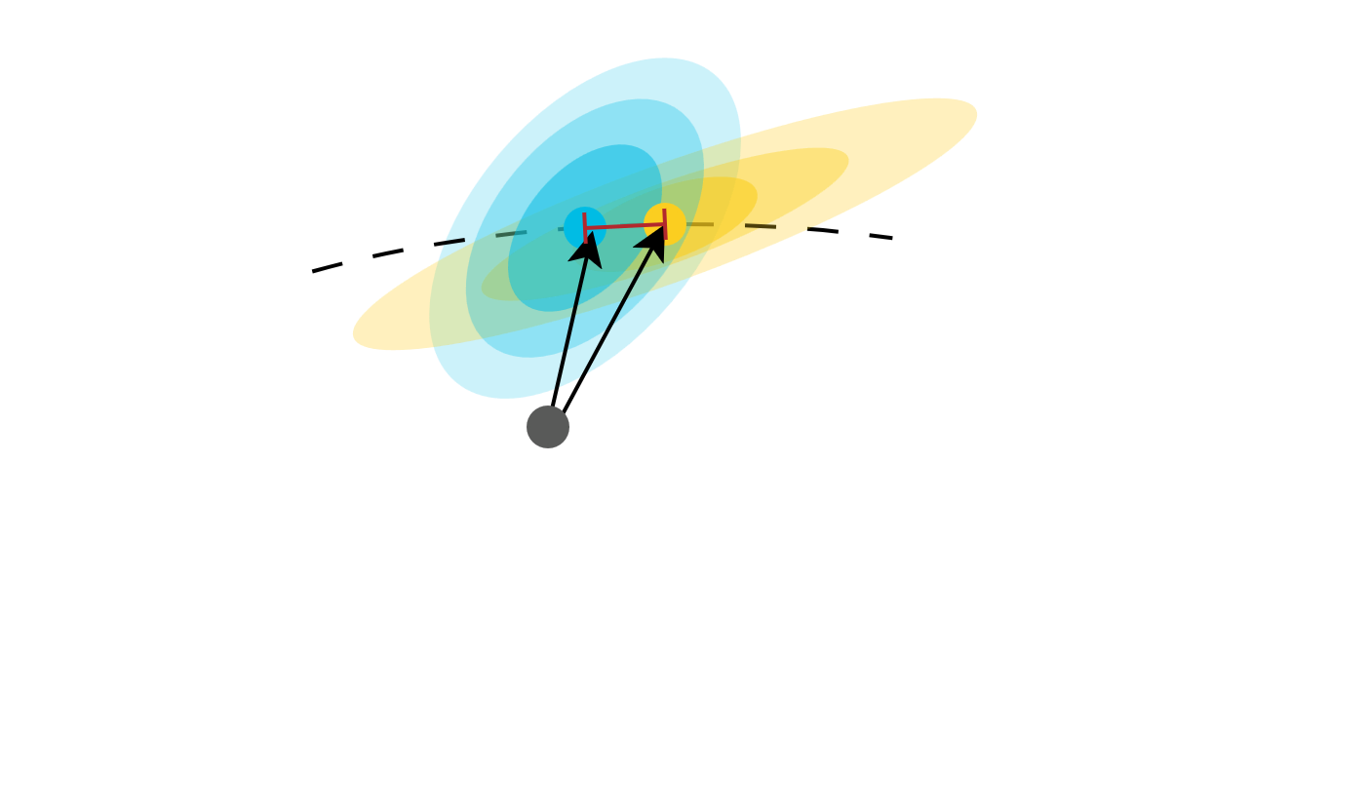
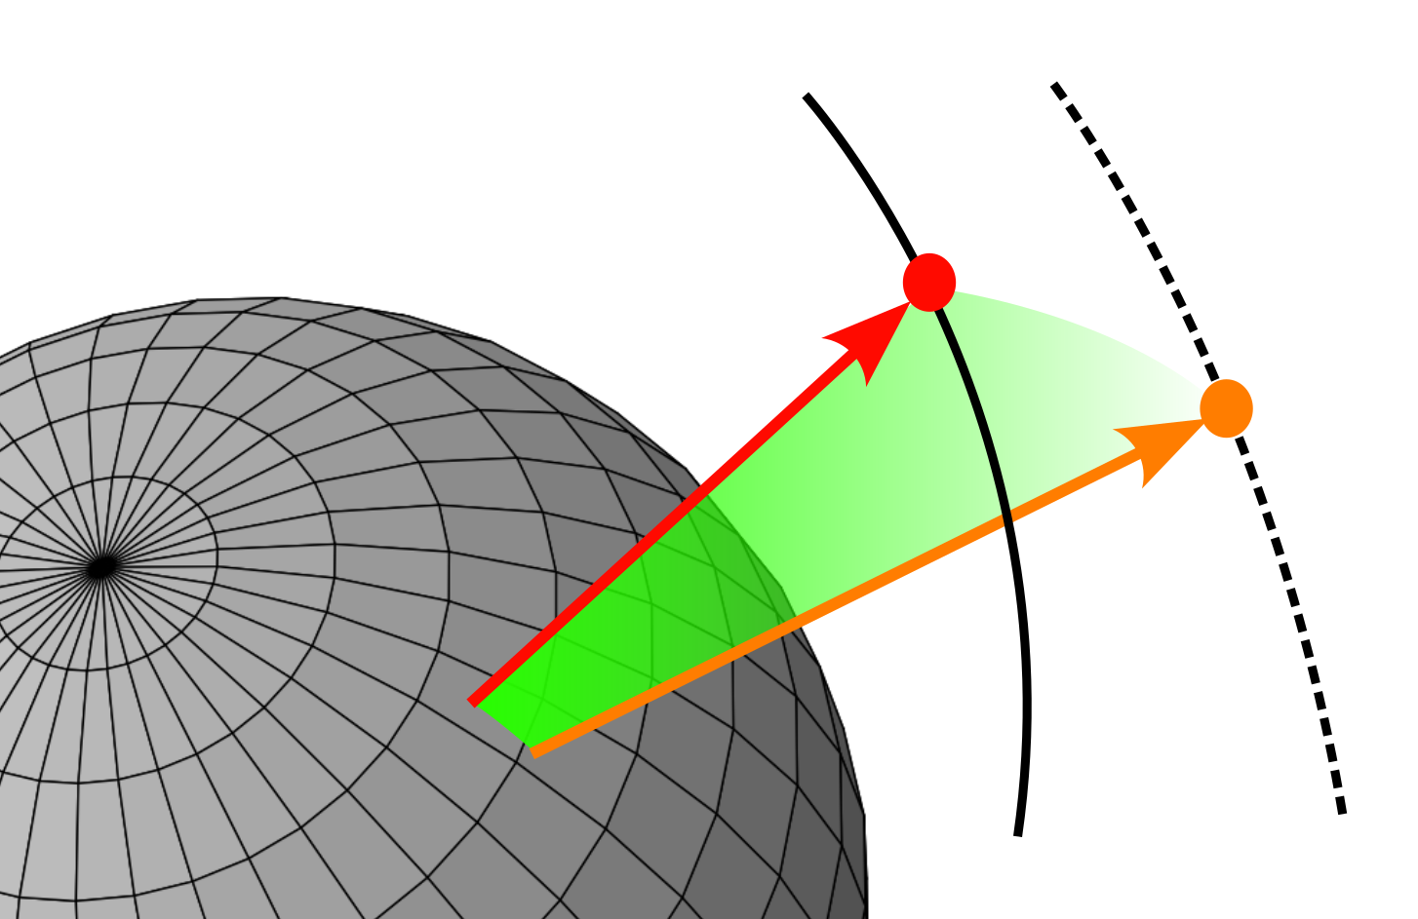

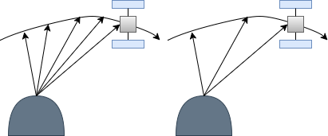
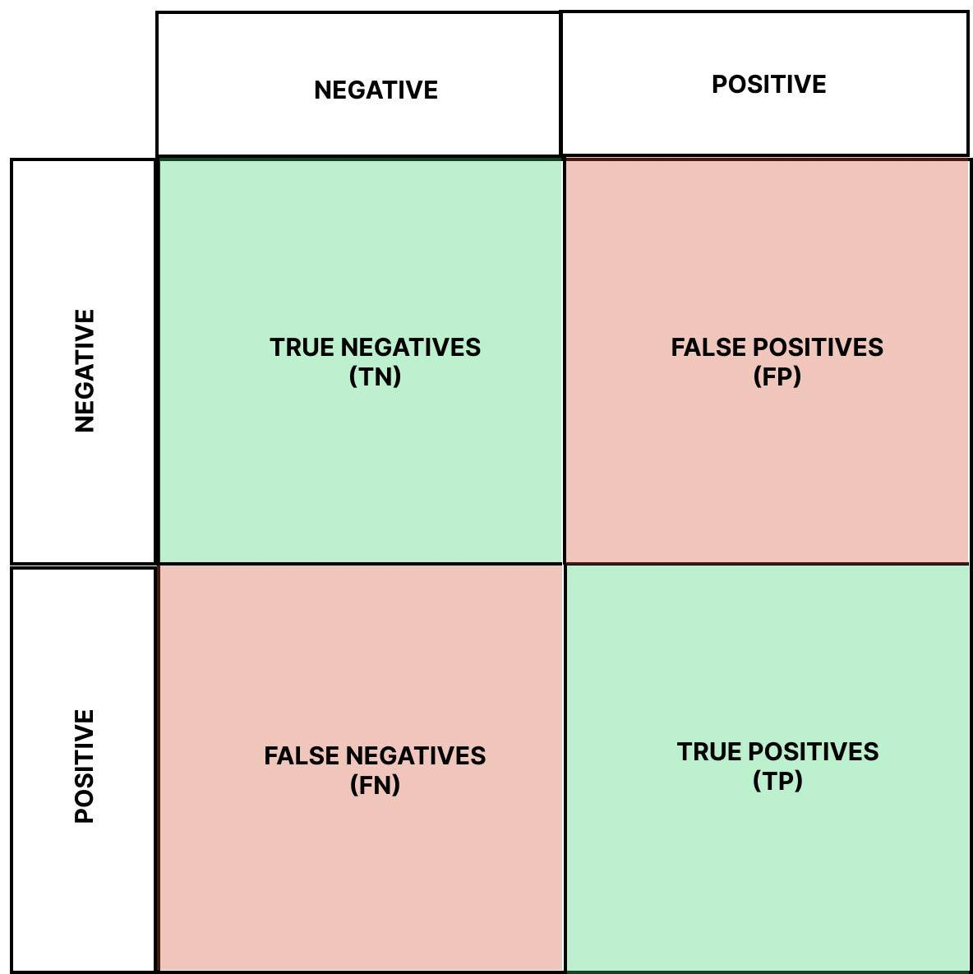
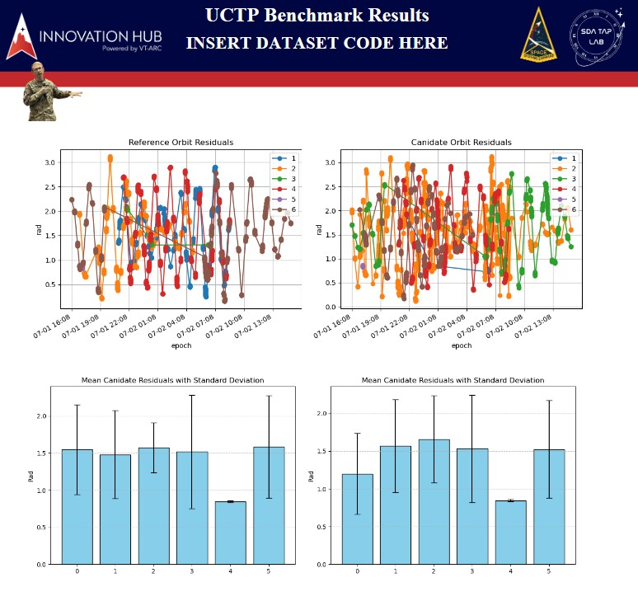
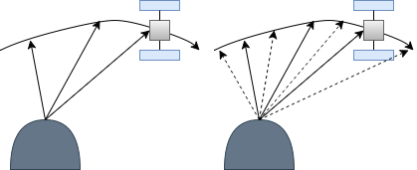
Benchmarking and Evaluating Uncorrelated Track Processing:
Common Task Framework at the SDA TAP Lab
Louis Caves Miles Puchner Binyamin Stivi Gabriel Lundin Cameron Smith
Uncorrelated Track (UCT) Processing
UCTs are observations or tracks of observations that do not correlate to any known objects
UCT processing is the task of correlating many UCTs together and assigning an orbital estimate
Solutions to UCT processing do not have a known solution to compare to
Need benchmark datasets with known solutions and performance metrics to evaluate UCTP performance
Dataset Generation:
UCTP Evaluation:
State Metrics
Residual Metrics
Orbit to Orbit Association
Orbit to Observation Association
Data Manipulation
Downsampling:
Selectively remove observations to emulate a sparser dataset
Binary Metrics
Evaluation Report
Observation to Observation Association
Simulation:
Selectively add observations to emulate a richer dataset

Slide 2
Designing and Briefing Your Poster
Content
Keep main bullets to one line
Allow sub-bullets to provide more detail if necessary
Don’t obscure your message with low-value data or the meaning by being too abbreviated
Graphics and Images
All text must be either Dark Blue, accent 1, or Black
Use the AFRL Color Palette for all charts and graphs
Choose graphics and images that add value
Briefing
Know what is on your poster plus a few talking points about your project
Do not assume your audience is familiar with your field of research
Lead with your main point, add context after catching the audiences’ attention
Practice a 30 second introduction and a 2-to-5-minute highlight speech that answers when, who, what, where, how, and why

Slide 3
PowerPoint Color Palette for Posters
Text:
Black Text 1
Tables and charts:
Main Blue R13 / G77 / B140
Yellow R251 / G206 / B32
Light Blue R0 / G188 / B228
Red R179 / G40 / B45
Light Gray R203 / G204 / B203
Dark Gray R89 / G90 / B89

